Slide 1


Slide 2
100 Machines do in 1s the work of 100s
Roberto Freato – Solution Architect / CTO @Witailer

Slide 3
Heavy workloads
Memory/Data intensive
I/O intensive
CPU intensive

Slide 4
Scenario
Message-driven
Producer: math operations (delay 1s)
Consumer: process messages => result
Viewer: result
Issues:
Operations takes m/l 1s

Slide 5
Solution
Scale-out: more machines
Efficiently, elegantly
Provisioning:
Azure Batch
Virtual Machine Linux
Storage Account
KeyVault
Service Bus

Slide 6
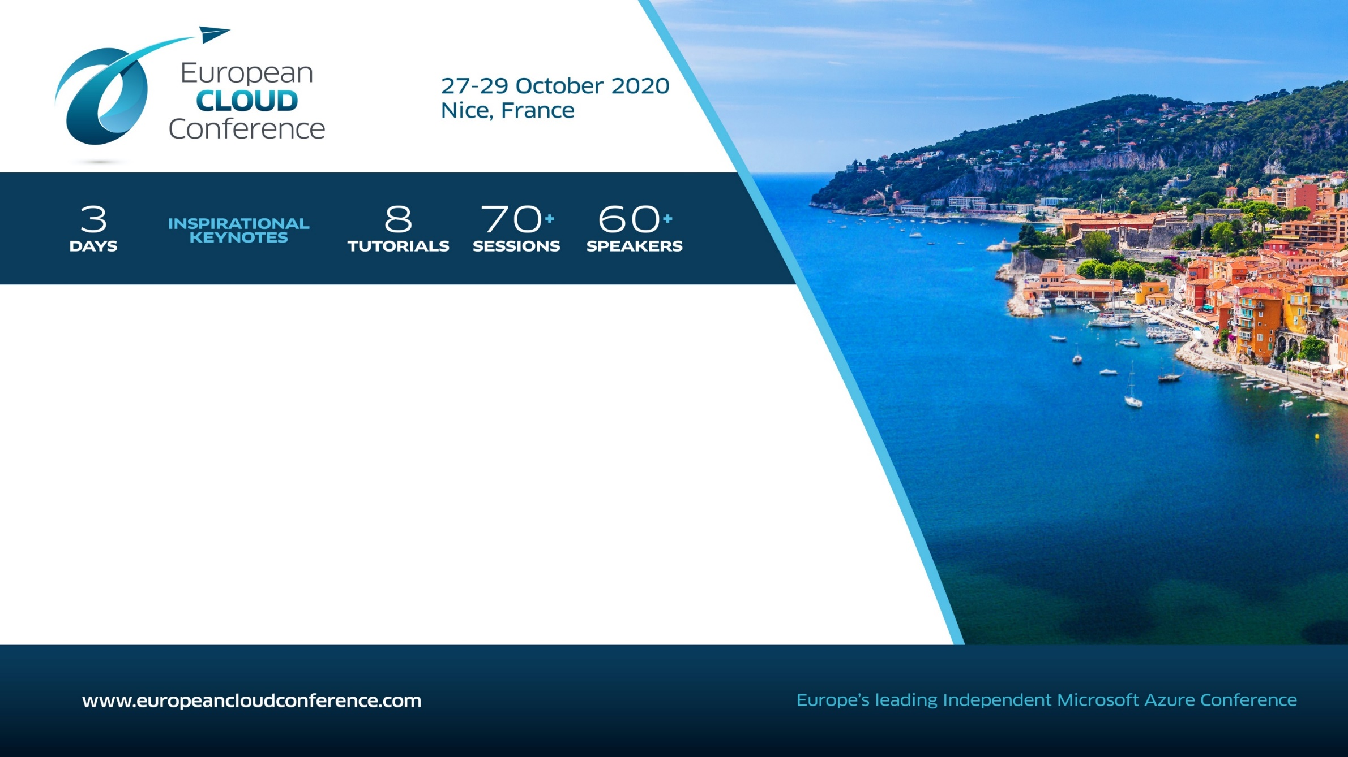
How to Enter?
Answer a simple question on the form below and select Turin Meetup Group – Two winners will be selected and notified before May 28th
https://europeancloudconference.com/win-a-free-ticket-to-the-european-cloud-conference-in-nice-france-gab/
N.B. Il link verrà inviato ai partecipanti via e-mail
#GLOBALAZURE2020

Slide 7




See you next October 2020 for
Global Azure 2020
Thank you for coming!
Continue your Azure Journey at https://docs.microsoft.com/learn/

